Slide 1
Every time you say:
“CLI is better than MCP”,
a clawdie dies 🦞😢
Jan Curn
@jancurn
Vibecoding Talks
20 April 2026

Slide 2
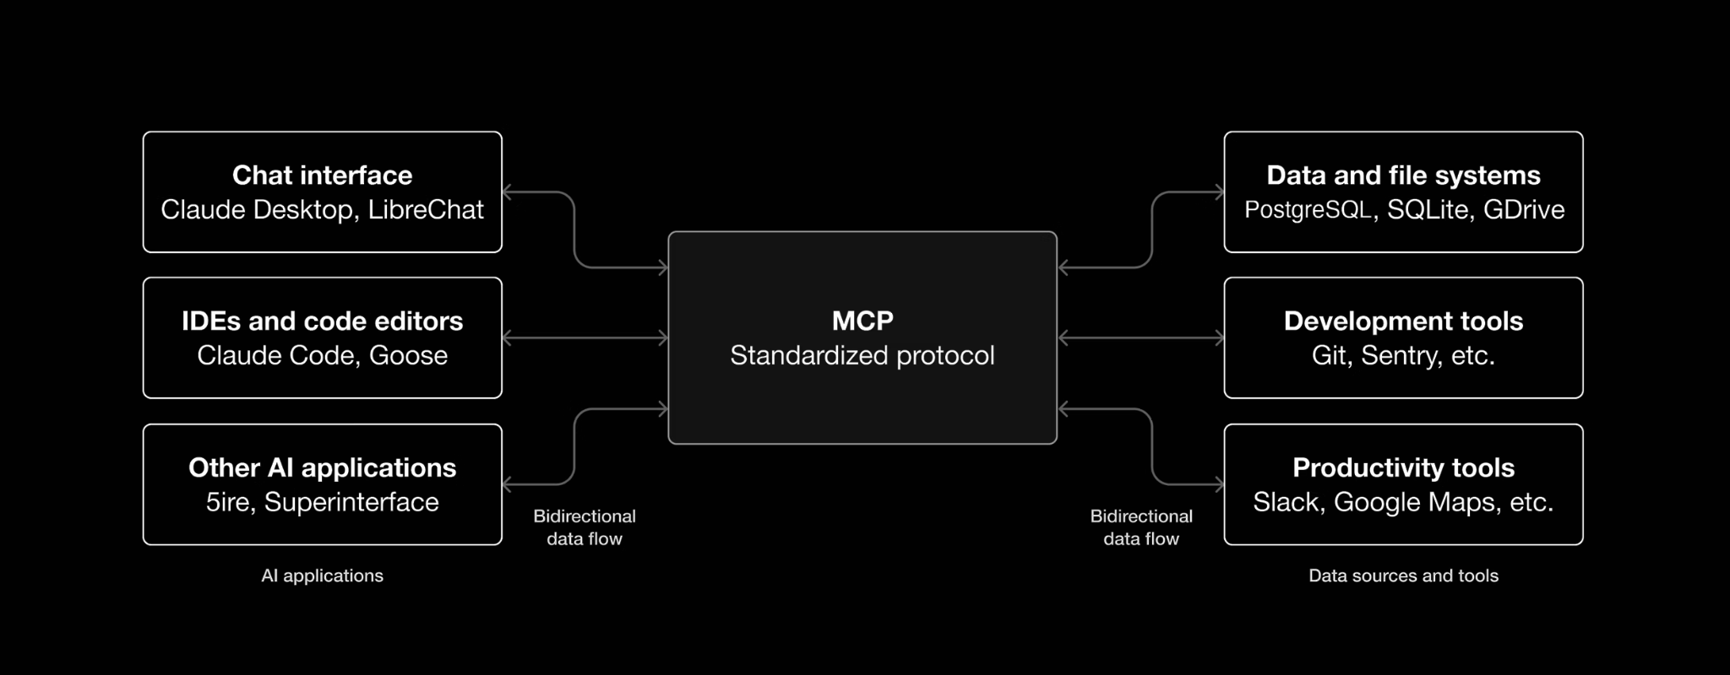
MCP is standard to securely access tools and resources
Notes:
MCP is a standard protocol to securely provide access to remote resources.
CLIs don’t have this - each CLI is using a different authentication mechanism, they are not standard - try to deploy them at scale.

Slide 3
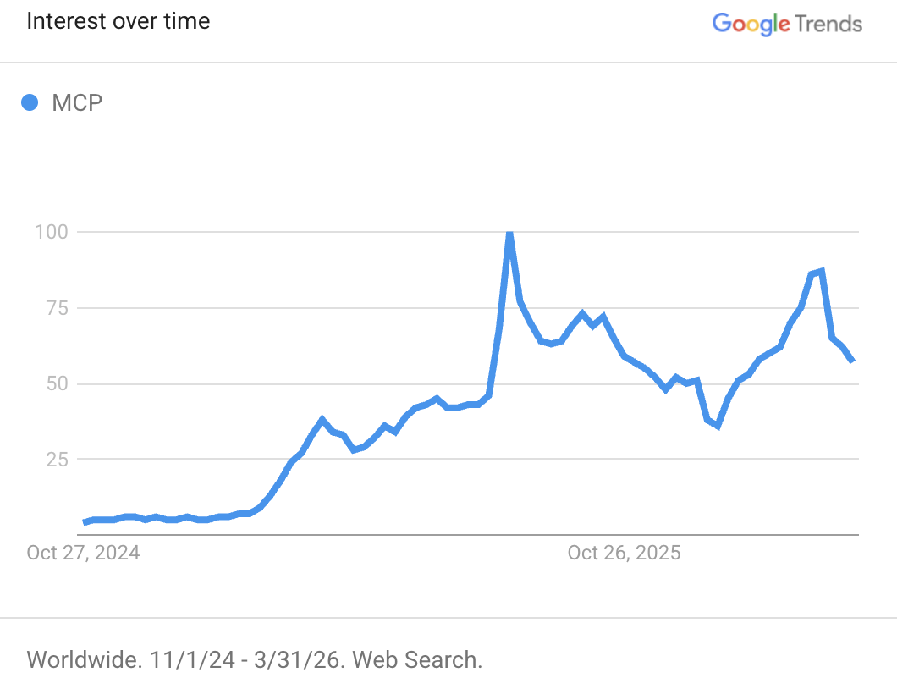
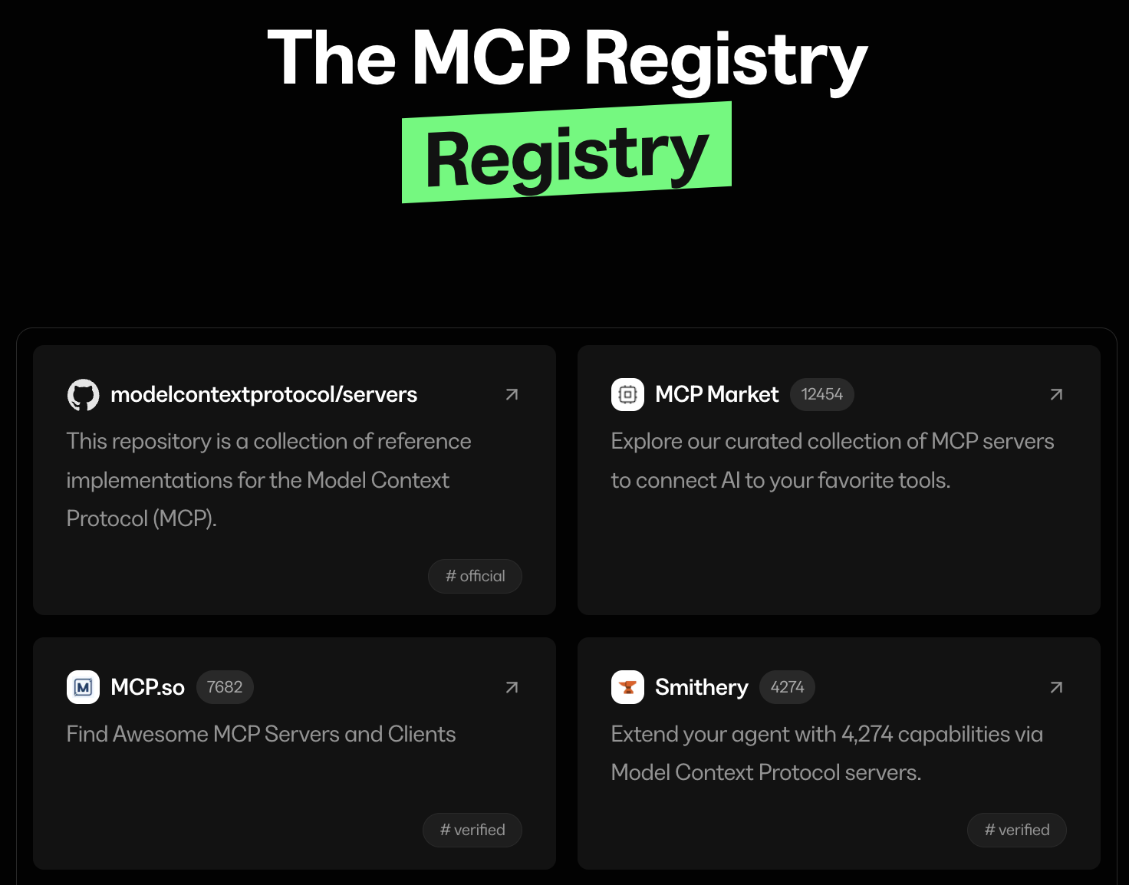
Last year, MCP became the darling
of the AI world

Slide 4
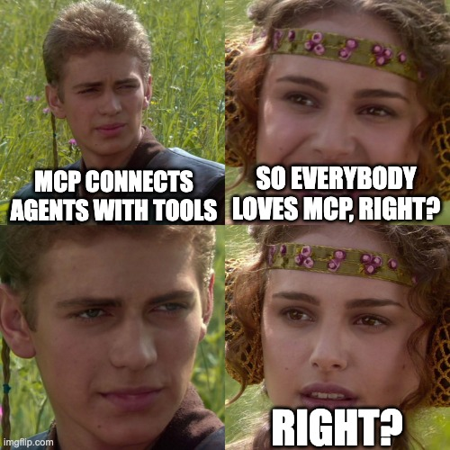

Slide 5
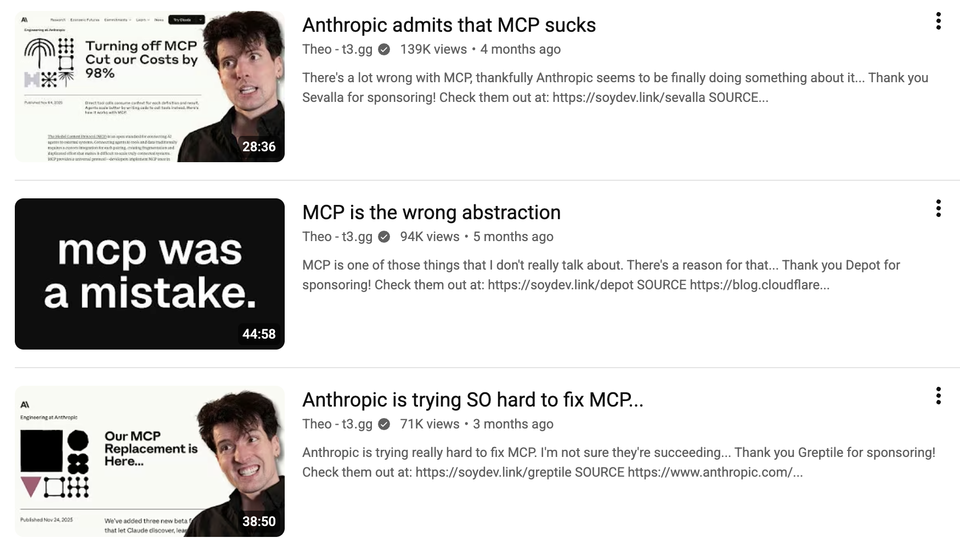

Slide 6
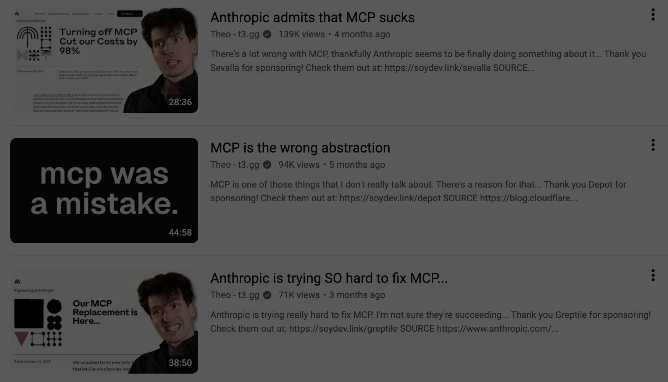
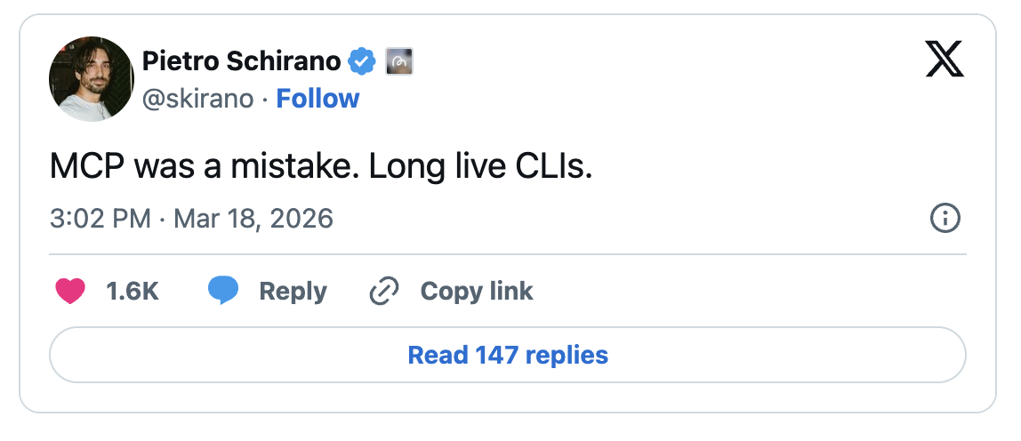

Slide 7
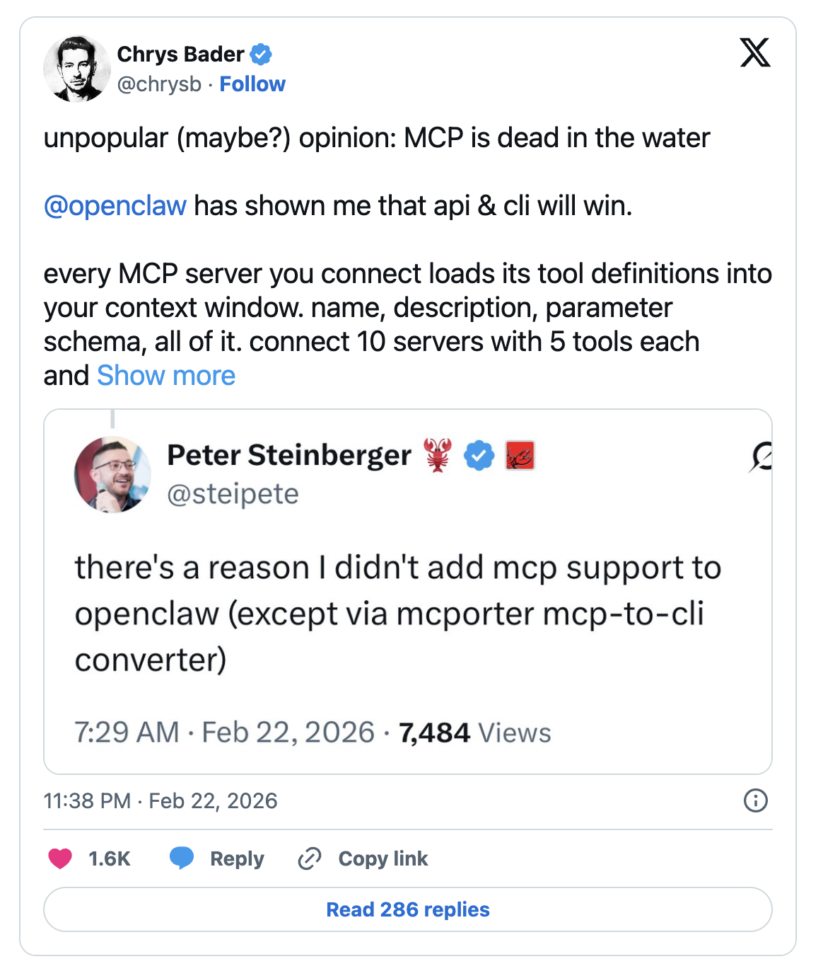
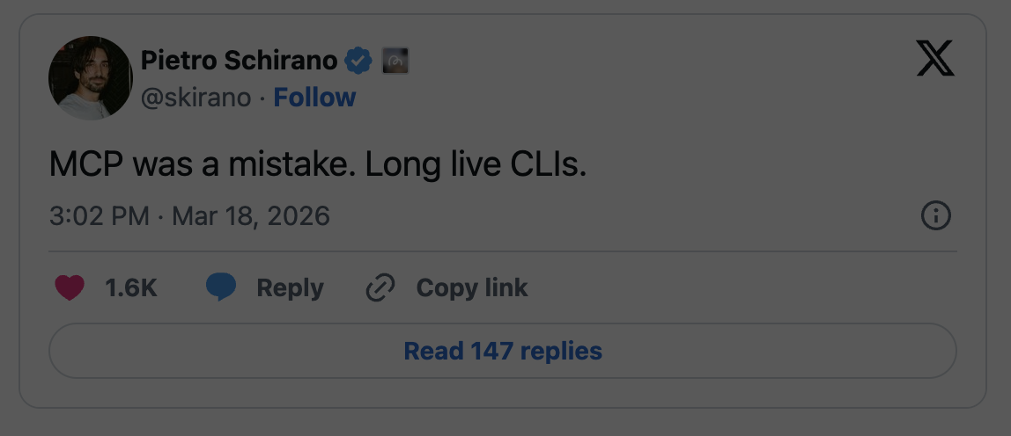

Slide 8
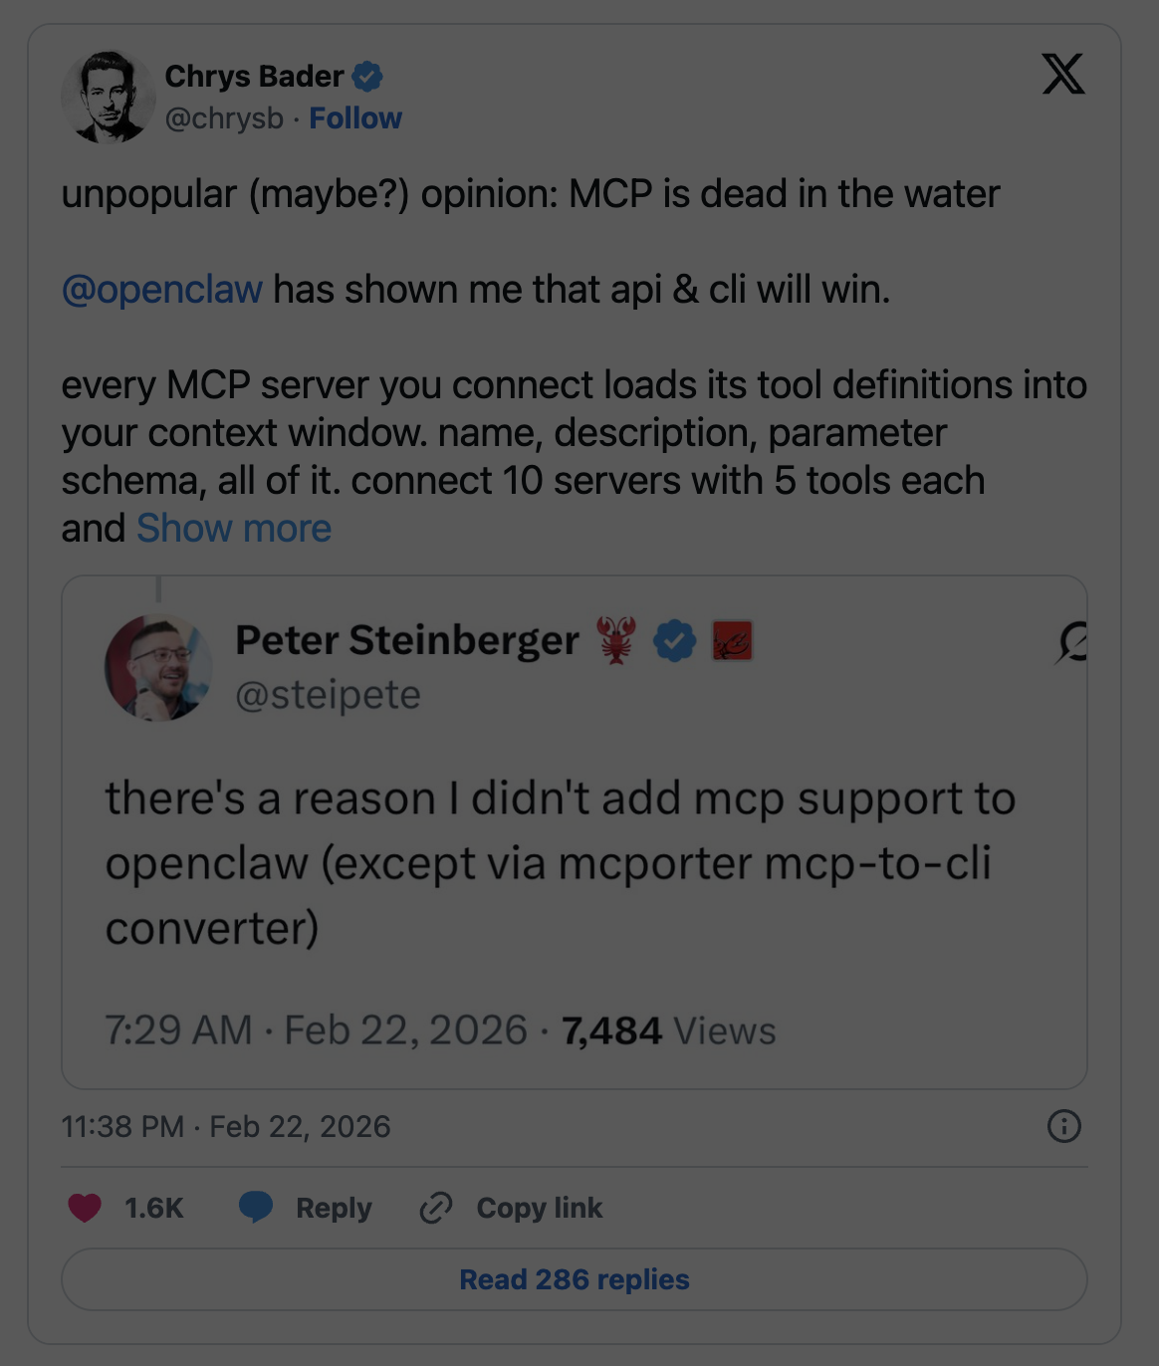
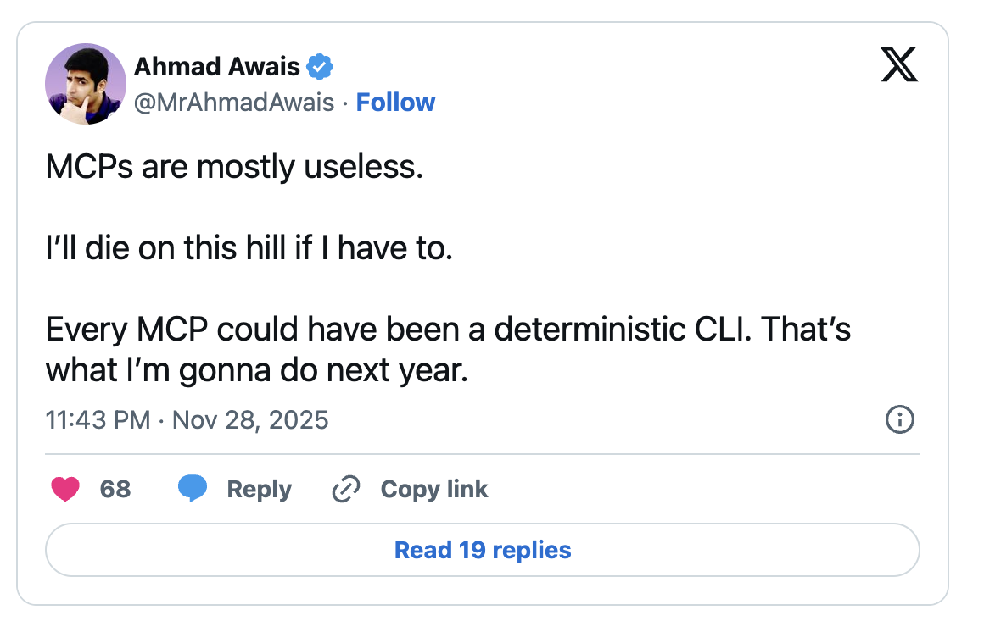

Slide 9
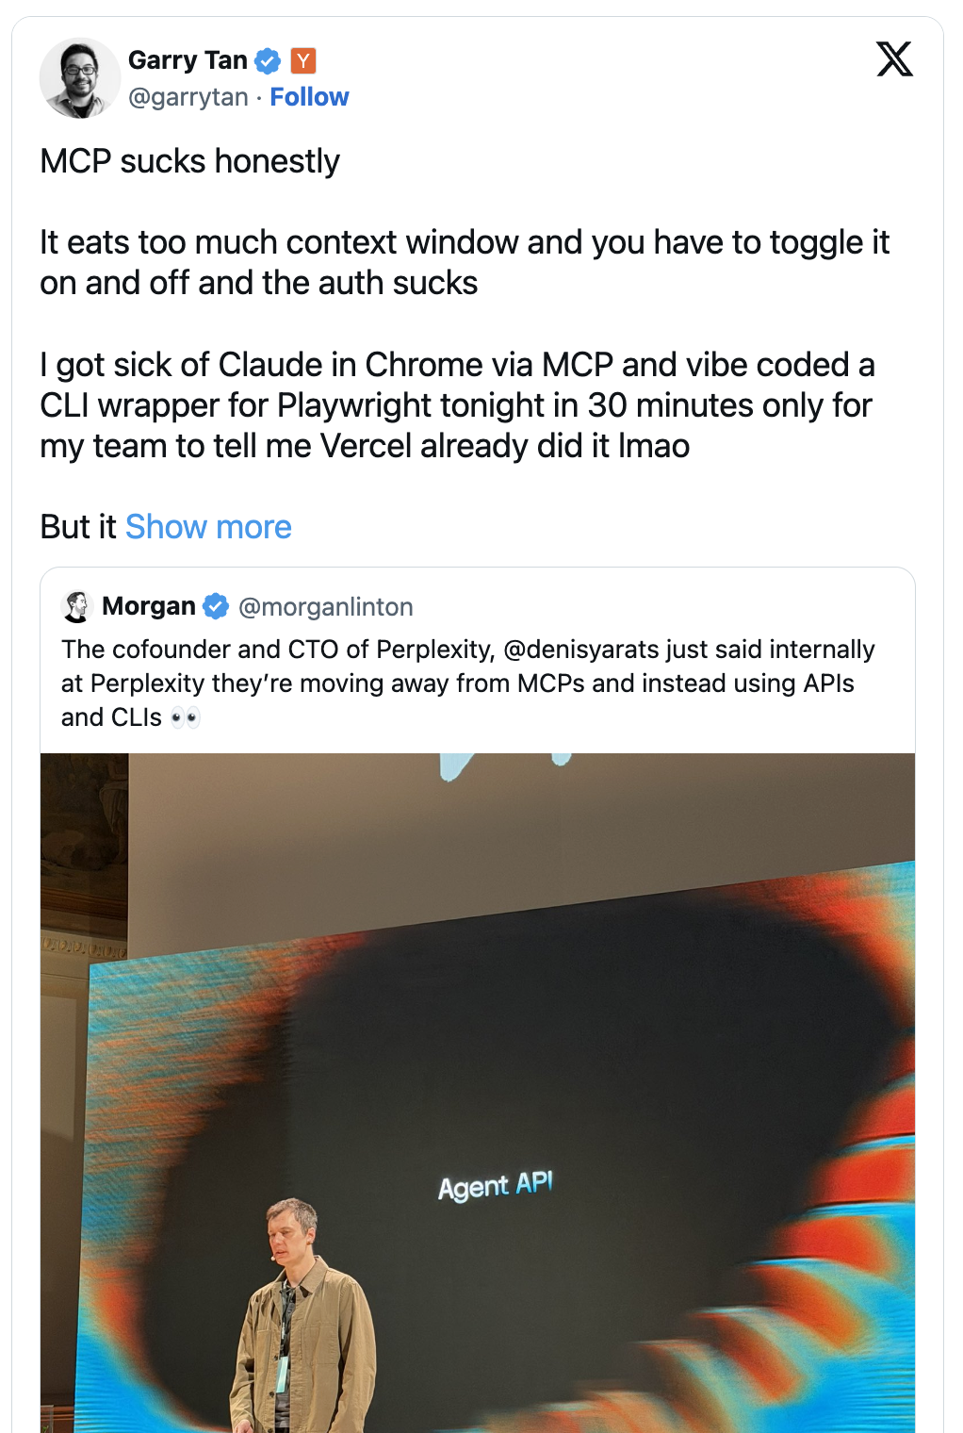
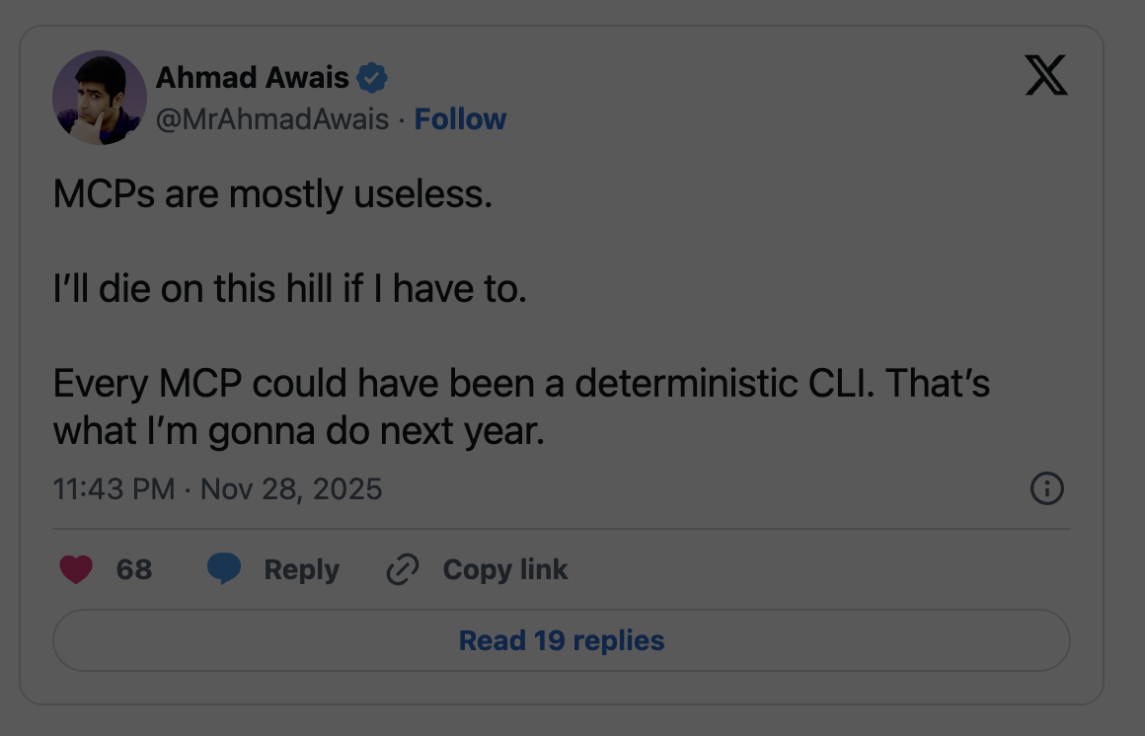

Slide 10
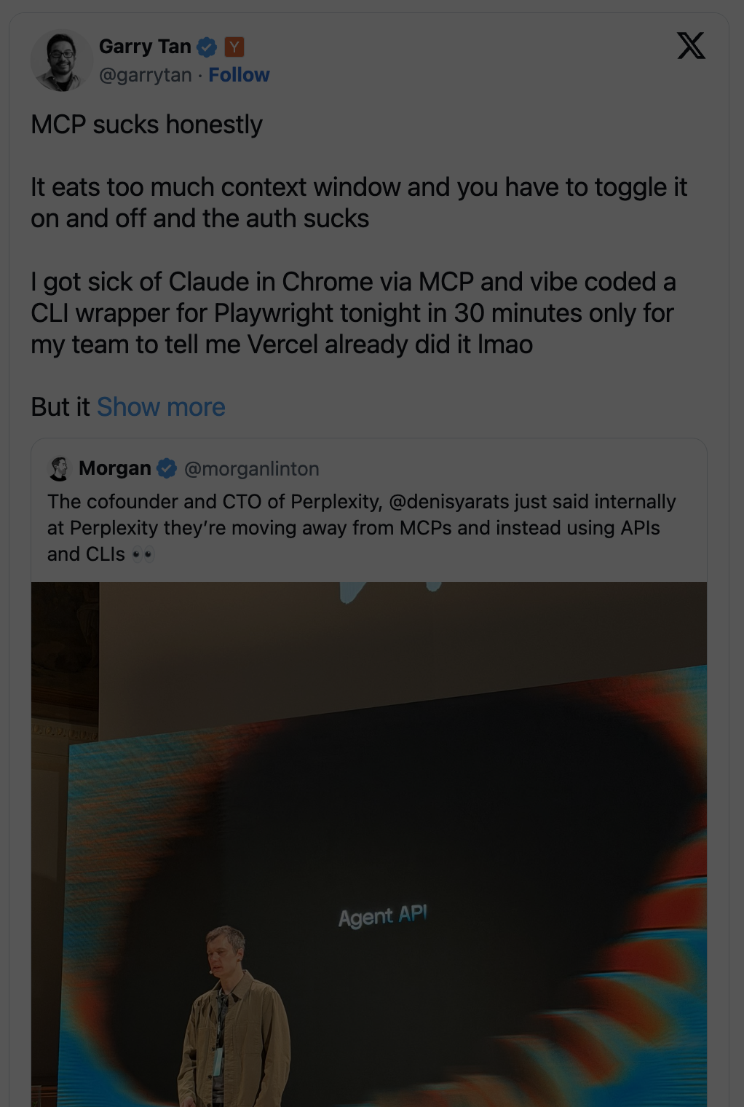
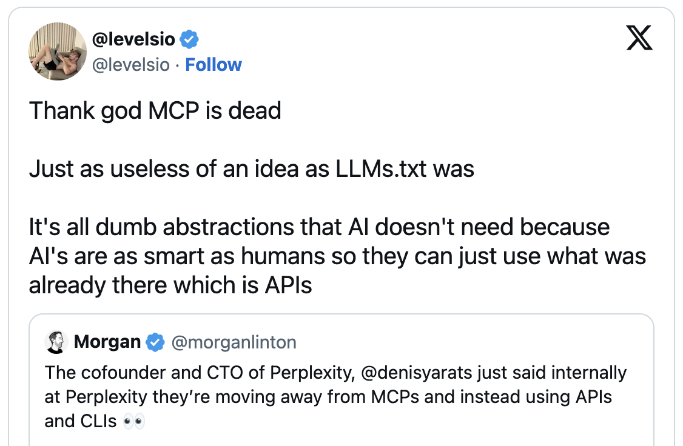

Slide 11

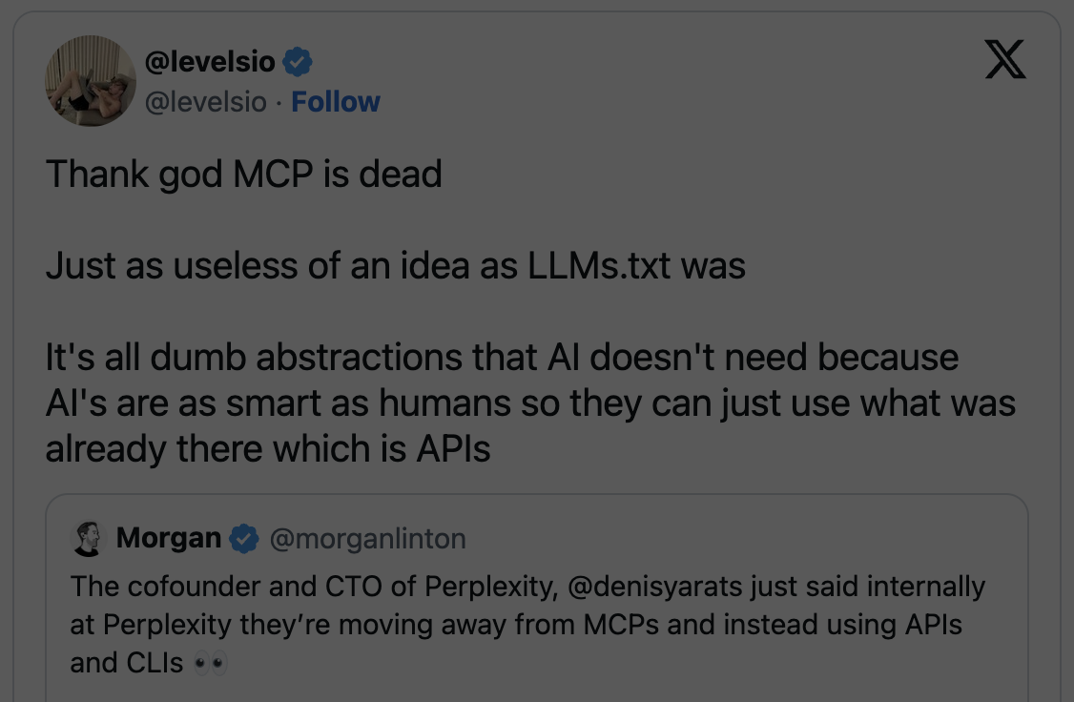
Notes:
TODO: Scared moji in clawd

Slide 12
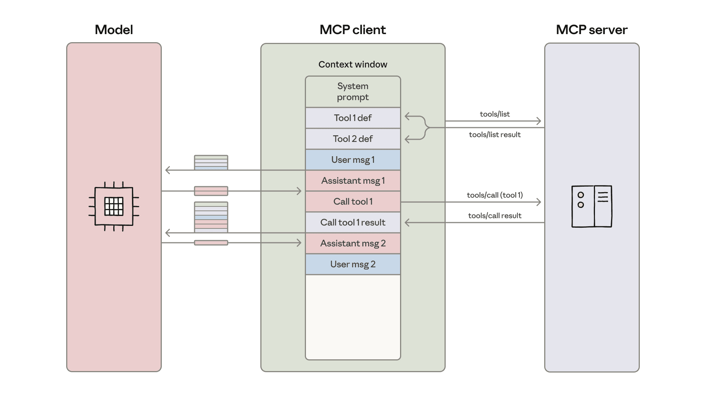
The problem: most agents load all MCP tools and their results into context
Image by Anthropic
Notes:
Tool inputs and outputs are stored in context
=> too expensive, context rot
Data leaked to the model => less secure

Slide 13
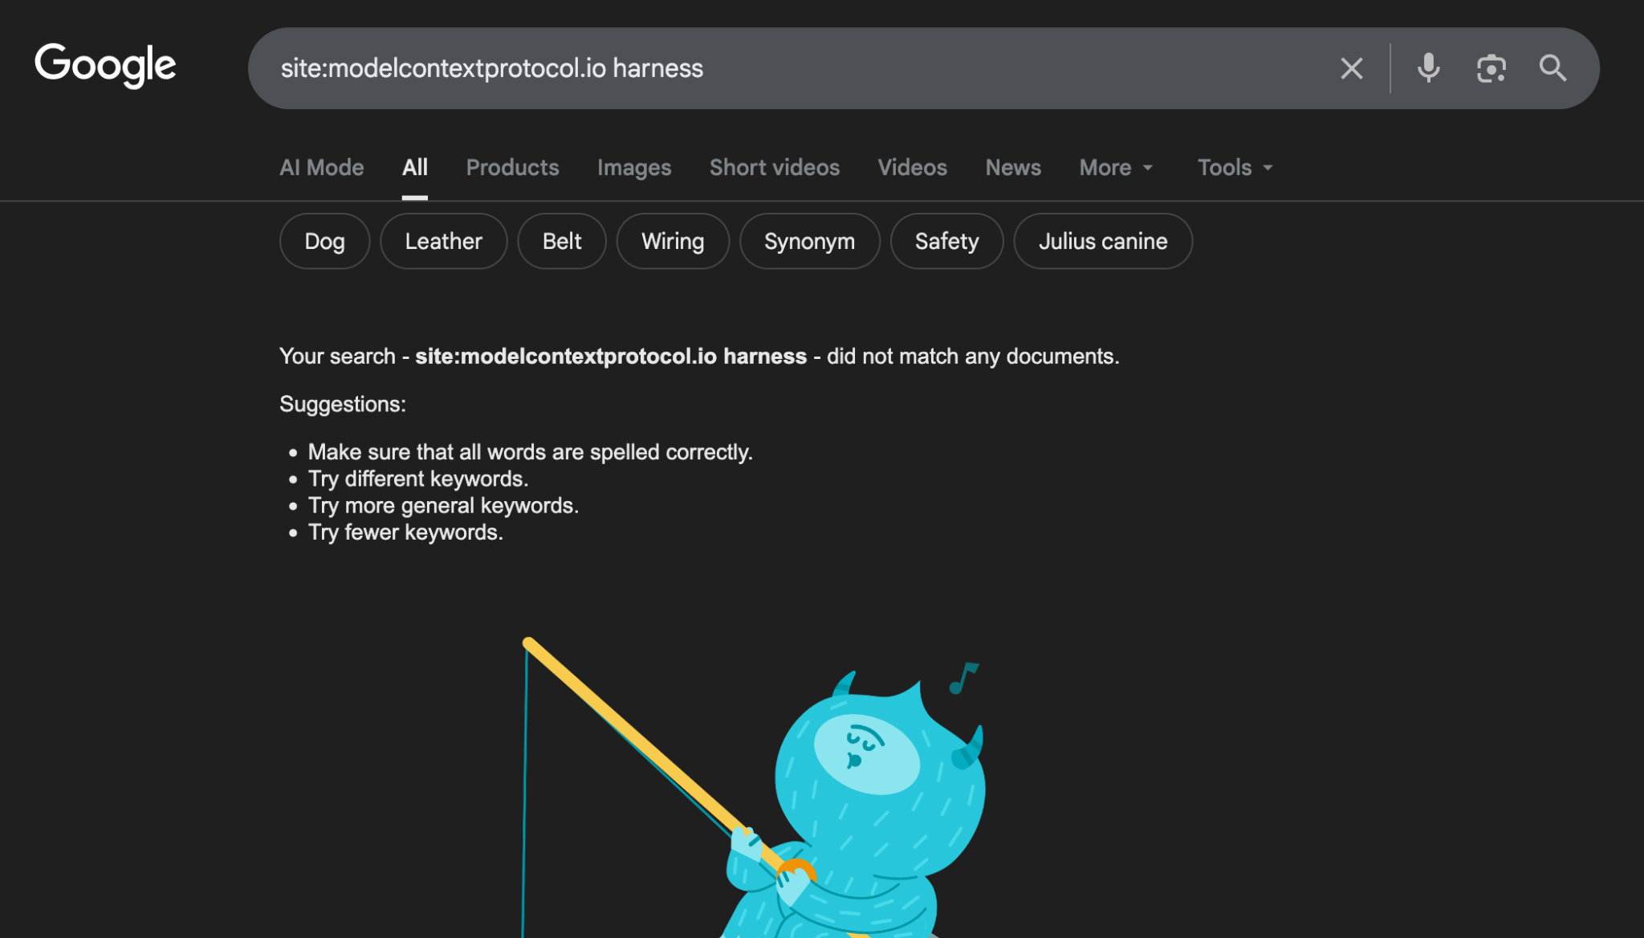
But that’s a problem of the harness,
not MCP!
Notes:
It’s the sloppy AI agents and MCP clients that cause the context problem, not the protocol!

Slide 14
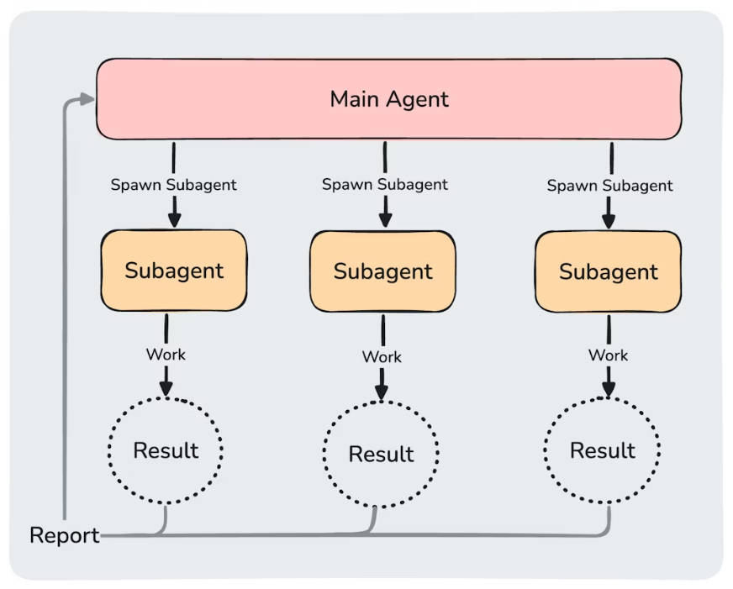
Solution 1: Split context into sub-agents
Image by Anthropic
Image by Anthropic
Notes:
Tool inputs and outputs are stored in context
=> too expensive, context rot
Data leaked to the model => less secure

Slide 15
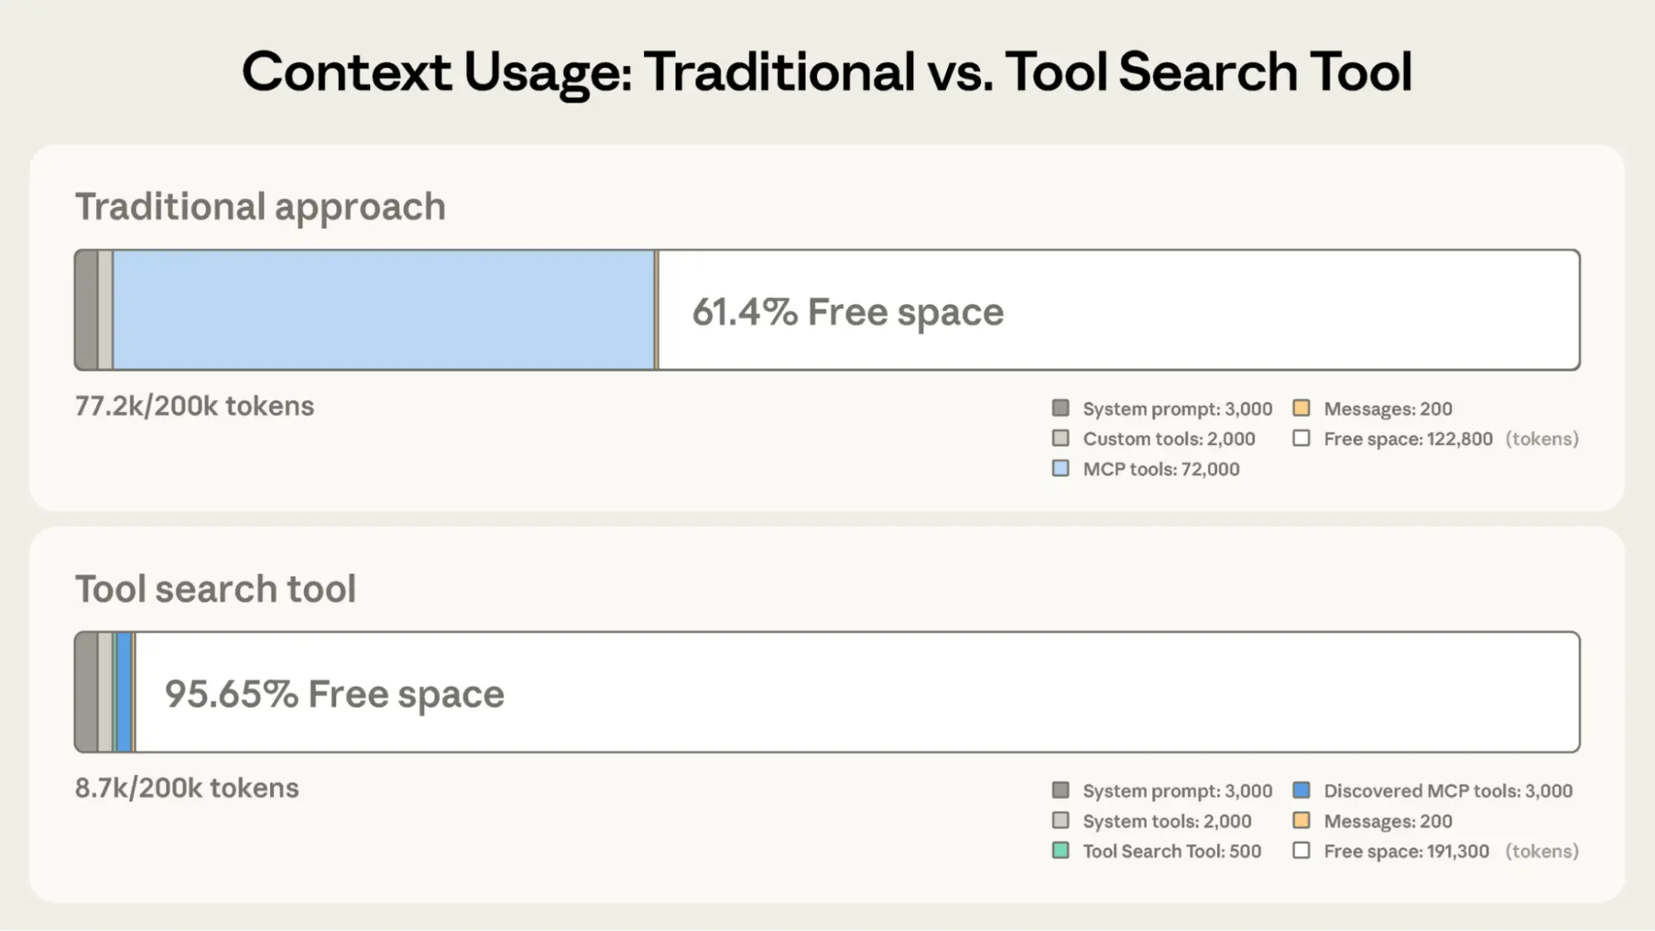
Solution 2: Progressive tool discovery
Image by Anthropic
Image by Anthropic
Notes:
Tool inputs and outputs are stored in context
=> too expensive, context rot
Data leaked to the model => less secure

Slide 16
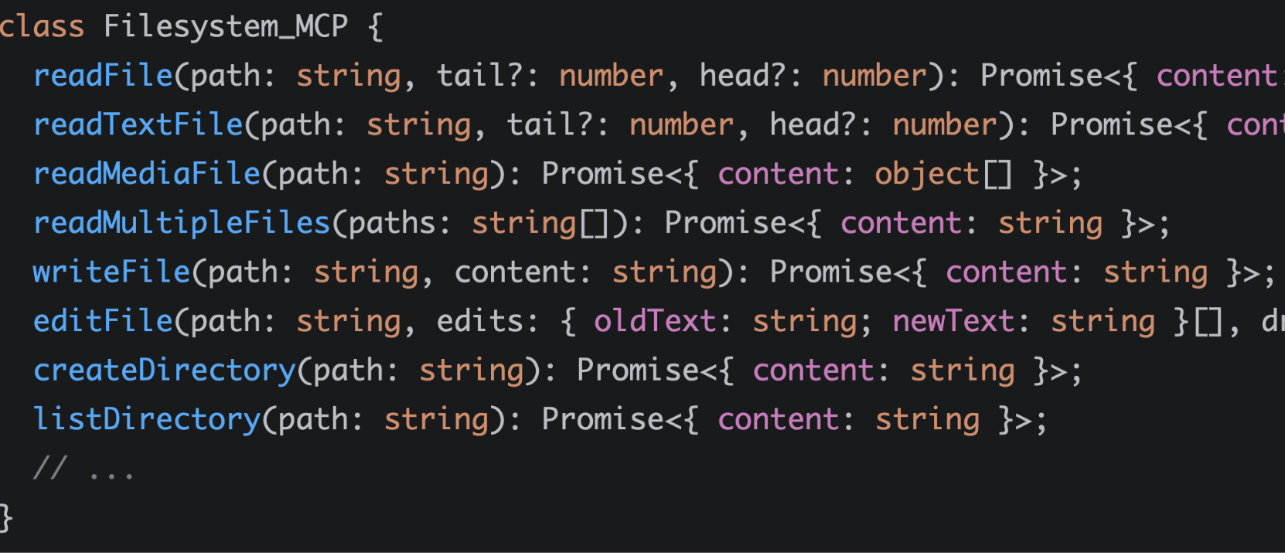
Solution 3: Treat tools as code
(code mode)
Image by Anthropic
Notes:
Introduced by Cloudflare in December - treat tool definitions as code

Slide 17
…but most clients don’t
support these features!
How are CLIs different?
Notes:
It’s the sloppy AI agents and MCP clients that cause the context problem, not the protocol!

Slide 18
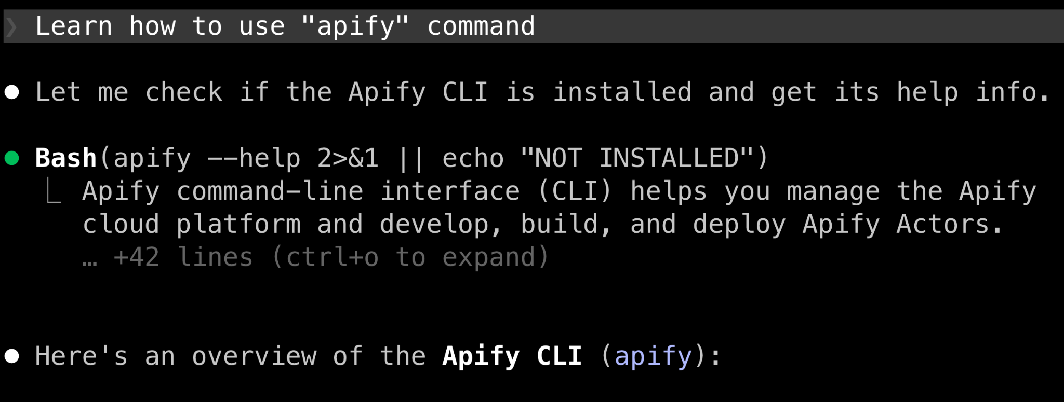
Agents never load CLIs and their docs into context at once, but progressively
Image by Anthropic
Notes:
they only need one tool: Bash() and a way to find commands
sometimes the LLMs knows the CLI tools by heart, sometimes through agent skills, sometimes by reading the help and sub-command help … but never all at once!
TODO: image eg. from claude coe

Slide 19
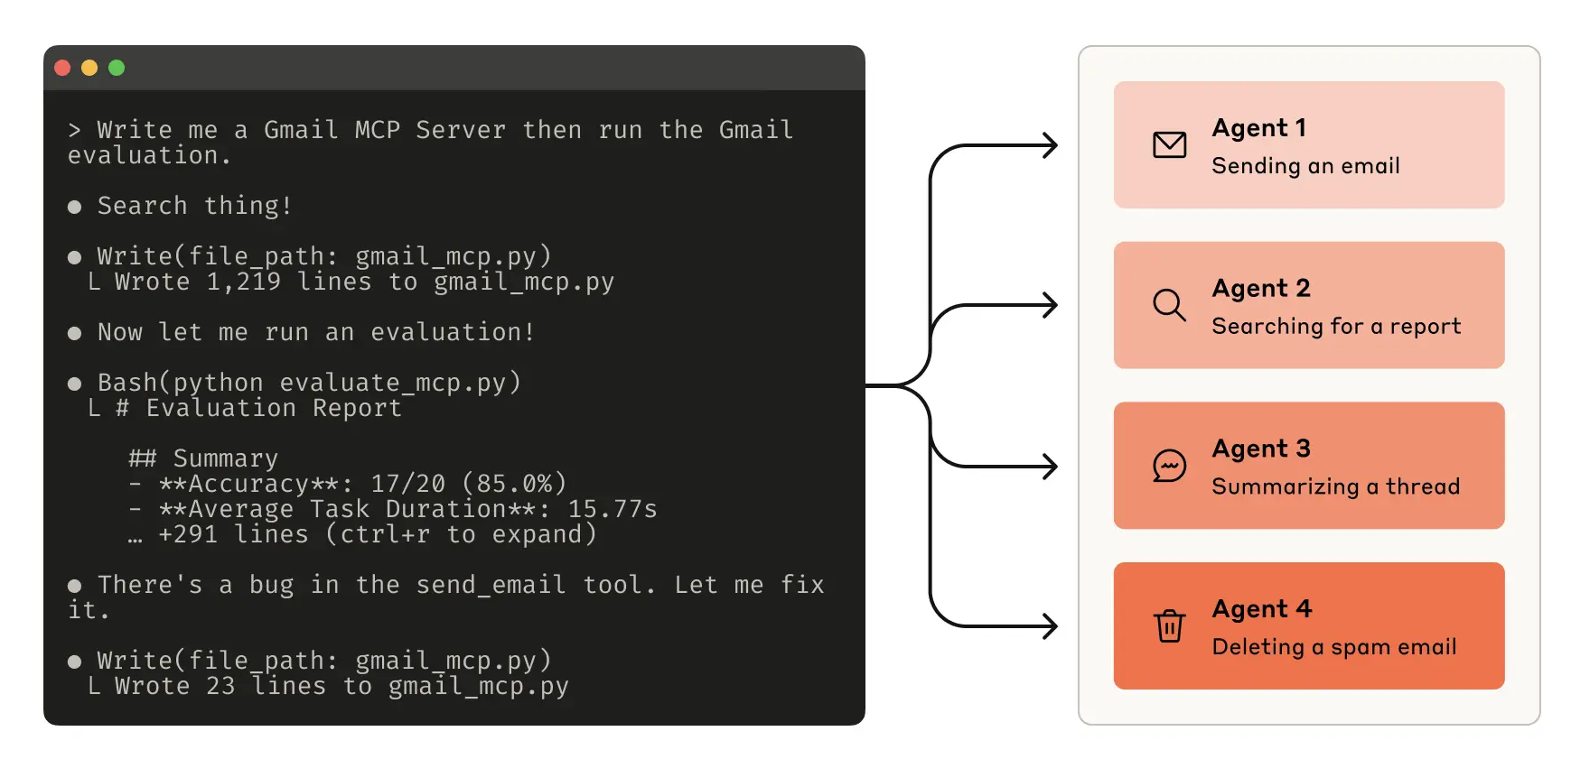
Agents run CLI tools as code by default

Slide 20
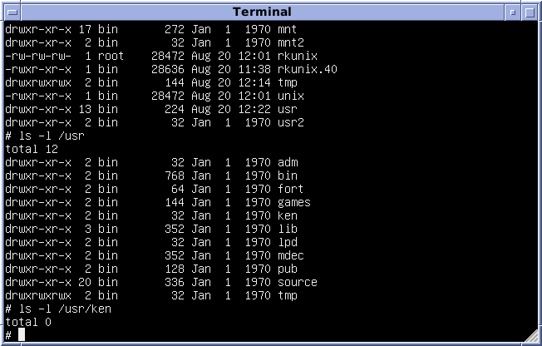
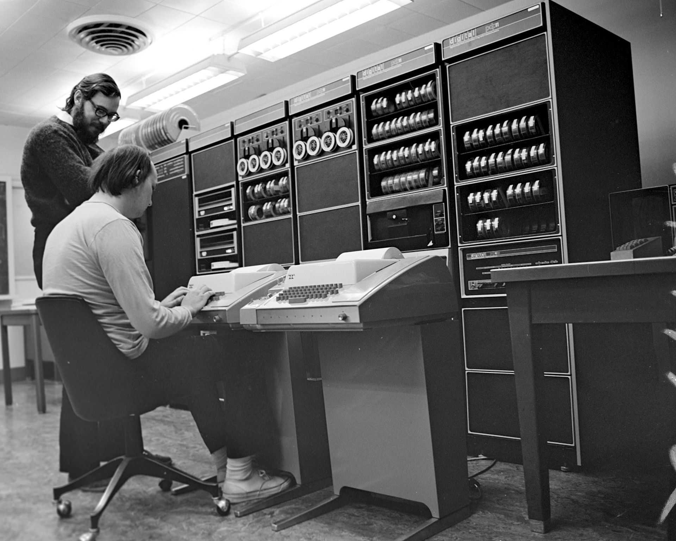
Agents know the shell by heart
Notes:
TODO: Some meme to show there’s no standard for CLI auth!

Slide 21
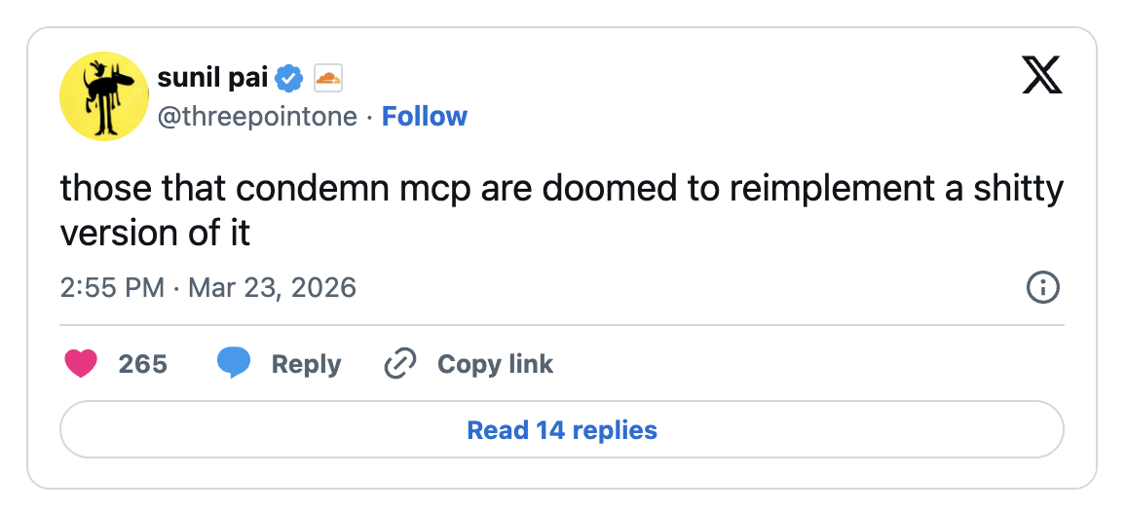
But CLIs are a local black box, with no standard auth and transport protocol
Notes:
That means you can’t easily control how CLIs access remote servers, handle auth, adjust privileges, intercept requests … they are literally a black box!

Slide 22
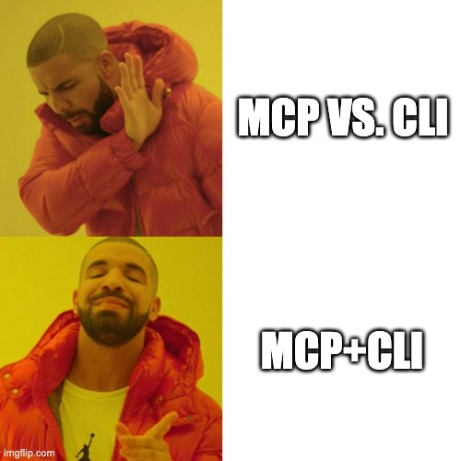
How about we use:
MCP for standard remote access
CLI for local agent interface

Slide 23
Agent can interact with MCP CLI
using single tool: Bash()
AI agent
…
MCP CLI
MCP server
MCP SDK for TypeScript
MCP server
Image by Anthropic
Notes:
The AI agent doesn’t need to understand and implement all the SDK features, it just needs Bash()

Slide 24
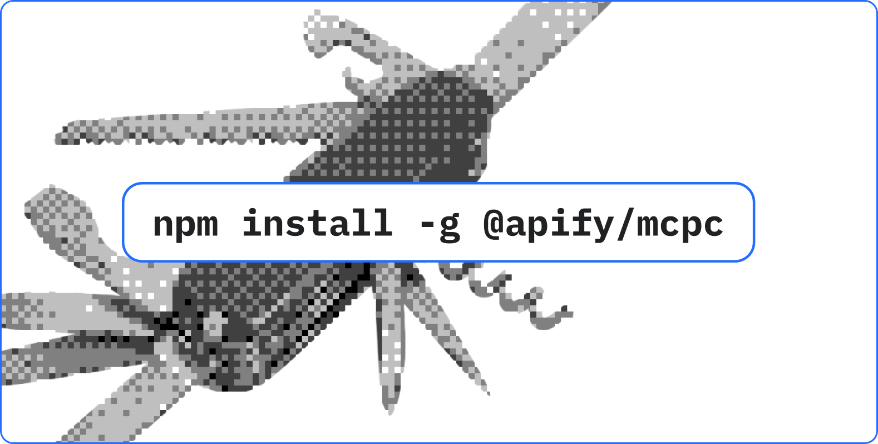
Say hello to mcpc 👋
the universal CLI client for MCP

Slide 25
mcpc design goals
Full MCP support & compatibility
Lightweight - no LLM, min deps
Easy to use for agents and humans
Code mode with --json all the way
Image by Anthropic
Notes:
they only need one tool: Bash() and a way to find commands
sometimes the LLMs knows the CLI tools by heart, sometimes through agent skills, sometimes by reading the help and sub-command help … but never all at once!

Slide 26
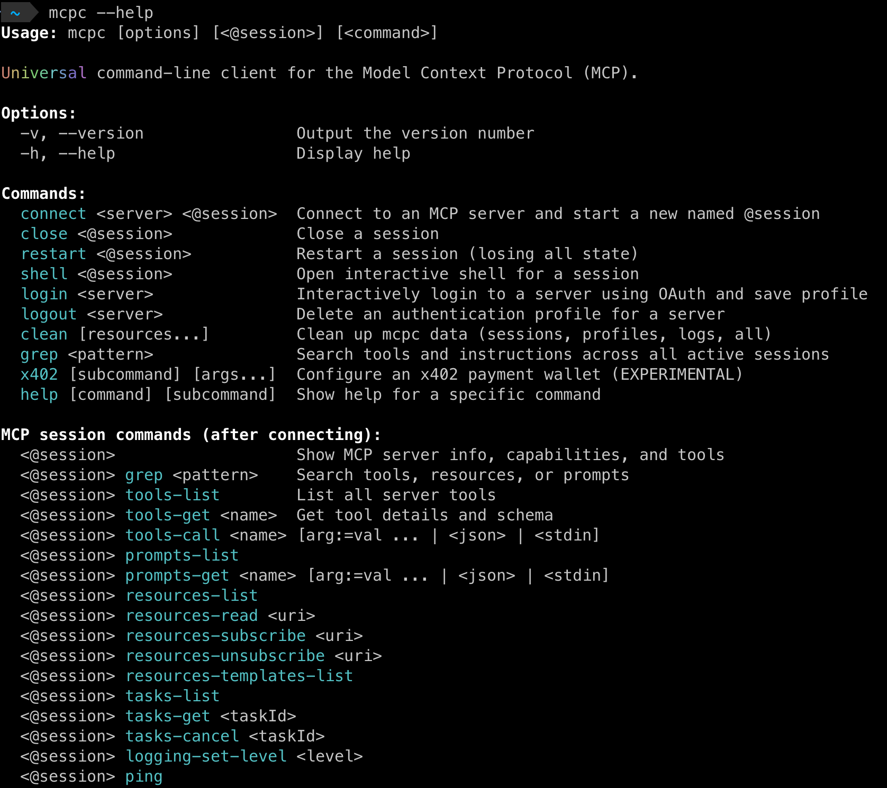
Notes:
TODO: image/text
shell interface is the most universal programming interface to humans and AIs
LLMs know how to write shell code, chain and use commands

Slide 27
Demo 1:
Sessions and auth profiles
Notes:
Demo 1 - sessions and profiles

Slide 28

Notes:
Demo 1 - sessions and profiles

Slide 29
Demo 2:
Dynamic tool discovery
Notes:
Demo 1 - sessions and profiles

Slide 30

Notes:
Demo 2 - dynamic tool discovery

Slide 31
Demo 3:
Async tasks
Notes:
Demo 1 - sessions and profiles

Slide 32

Notes:
Demo 3 - MCP tasks

Slide 33
Demo 4:
Code mode with --json
Notes:
Demo 1 - sessions and profiles

Slide 34

Notes:
Demo 4 - MCP tasks

Slide 35
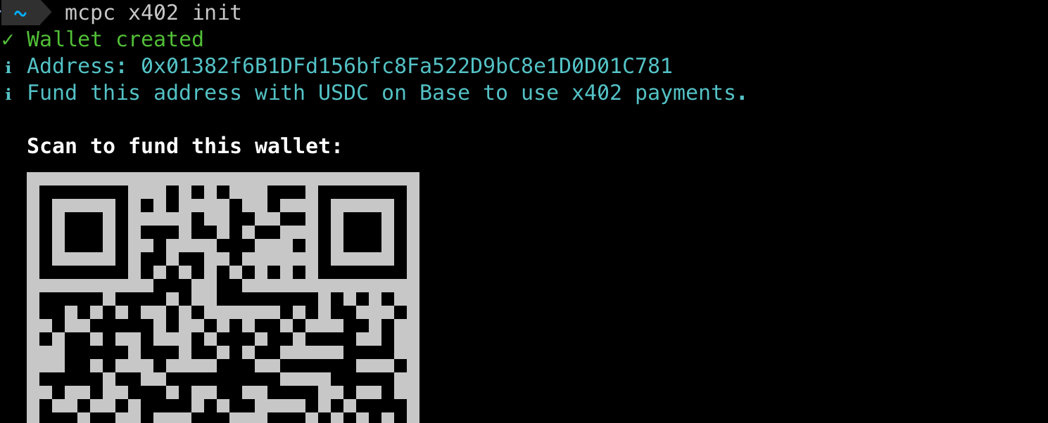
Supports agentic payments
mcpc x402
Notes:
TODO: Some meme to show there’s no standard for CLI auth!

Slide 36
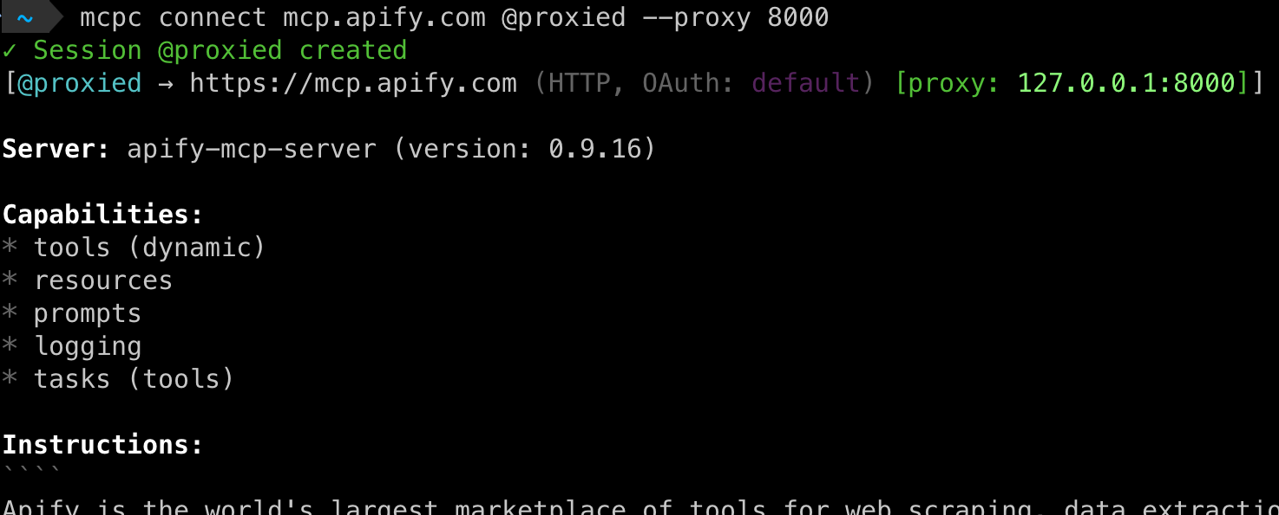
MCP proxy for secure sandbox access
mcpc connect --proxy
Notes:
TODO: Some meme to show there’s no standard for CLI auth!

Slide 37
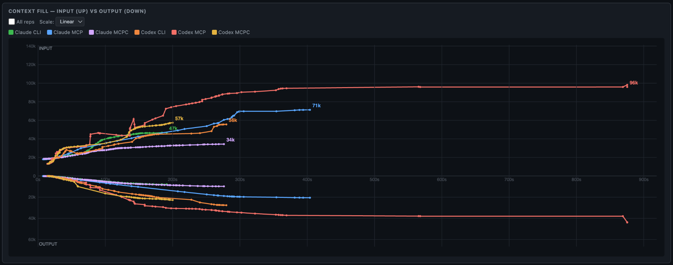
In our tests, mcpc often outperforms native CLIs and naive MCP
Notes:
TODO: Some meme to show there’s no standard for CLI auth!

Slide 38
Final remarks
MCP clients lag behind the standard
Current MCP SDKs are too low-level
We need an official SDK for shell
Apify ready to donate mcpc to AAIF
We can kill the CLI vs. MCP nonsense!
Image by Anthropic
Notes:
MCP protocol is developing faster than the ecosystem - most clients suck, don’t support new features, load all tools into context etc.
We have official SDKs for TS, Python, Go, etc. but not official SDK for the shell.
We’re ready to donate mcpc to Agentic AI foundation and turn it into the official MCP CLI client.
This might kill the CLI vs. MCP hate once for all!

Slide 39

So, stop saying CLI is better than MCP, because MCP+CLI is even better.
And let the clawdies live!

Slide 40

Please give mcpc a try and GitHub star
github.com/apify/mcpc
Jan Curn
@jancurn
Notes:
TODO: Some meme to show there’s no standard for CLI auth!

